Slide 1
Political & Economic Environment
International Business
Southeast University
M. Shahadat Hossain

Slide 2
Effect of National Differences on International Business
CHALLENGES
Legal-Political
Implementation
Value Chan Management
Control
Individual and Company Concerns
National
Differences
Economic
Human

Slide 3
The Political Spectrum
Reactionary
Authoritarian
Fascist
Conservative
DEMOCRACY
Democratic government
Nondemocratic government
TOTALITARIANISM
Communist
Liberal
Radical
Authoritarian

Slide 4
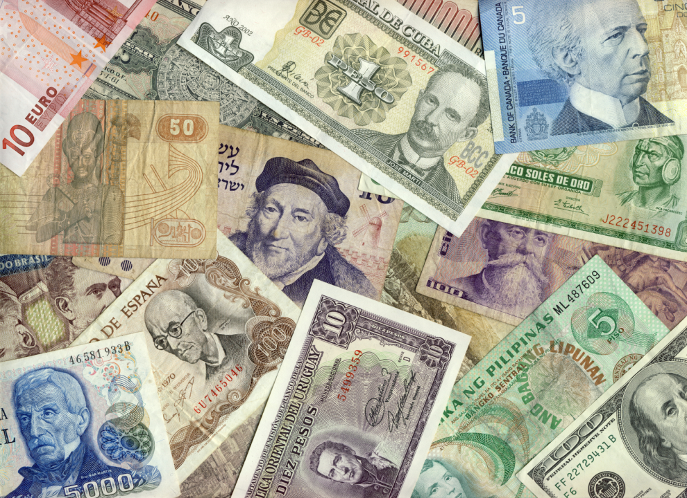
The World Economy—An Overview
In the early twentieth century economic integration was at 10%; today it is 50%
EU and NAFTA are very integrated
Global competitors have displaced or absorbed local ones

Slide 5
The World Economy—An Overview
The new realities
Capital movements have replaced trade as the driving force of the world economy
Production has become uncoupled from employment
The world economy, not individual countries, is the dominating factor

Slide 6
The World Economy—An Overview
The new realities, continued
75-year struggle between capitalism and socialism has almost ended
E-commerce diminishes the importance of national barriers and forces companies to reevaluate business models

Slide 7
Economic Systems
Resource Allocation
Market Command
Private
Resource
Ownership
State
Centrally planned capitalism
Market capitalism
Market socialism
Centrally planned socialism

Slide 8
Market Capitalism
Individuals and firms allocate resources
Production resources are privately owned
Driven by consumers
Government’s role is to promote competition among firms and ensure consumer protection

Slide 9
Centrally Planned Socialism
Opposite of market capitalism
State holds broad powers to serve the public interest; decides what goods and services are produced and in what quantities
Consumers can spend on what is available
Government owns entire industries and controls distribution
Demand typically exceeds supply
Little reliance on product differentiation, advertising, pricing strategy

Slide 10
Centrally Planned Capitalism
Economic system in which command resource allocation is used extensively in an environment of private resource ownership
Examples
Sweden
Japan

Slide 11
Economic Freedom
Rankings of economic freedom among countries
free, mostly free, mostly unfree, repressed
Variables considered include such things as:
Trade policy
Taxation policy
Capital flows and foreign investment
Banking policy
Wage and price controls
Property rights
Black market

Slide 12
Economic Freedom
Repressed
Cuba
Belarus
Libya/Venezuela
Zimbabwe
Burma
Iran
North Korea
Free
Hong Kong
Singapore
Ireland
Luxembourg
Iceland/U.K.
Estonia
Denmark
Australia/New Zealand/United States

Slide 13
Stages of Market Development
The World Bank has defined four categories of development using Gross National Income (GNI) as a base
BEMs, identified 10 years ago, were countries in Central Europe, Latin America, and Asia that were to have rapid economic growth
Today, the focus is on BRIC, Brazil, Russia, India, and China

Slide 14
Low-Income Countries
GNP per capita of $825 or less
Characteristics
Limited industrialization
High percentage of population involved in farming
High birth rates
Low literacy rates
Heavy reliance on foreign aid
Political instability and unrest
Concentrated in Sub-Saharan Africa
India is the only BRIC country

Slide 15
Lower-Middle-Income Countries
GNI per capita: $826 to $3,255
Characteristics
Rapidly expanding consumer markets
Cheap labor
Mature, standardized, labor-intensive industries like textiles and toys
BRIC nations are China and Brazil

Slide 16
Upper-Middle-Income Countries
GNP per capita: $3,256 to $10,065
Characteristics
Rapidly industrializing, less agricultural employment
Increasing urbanization
Rising wages
High literacy rates and advanced education
Lower wage costs than advanced countries
Also called newly industrializing economies (NIEs)
Examples: Malaysia, Chile, Venezuela, Hungary, Ecuador

Slide 17
Marketing Opportunities in LDCs
Characterized by a shortage of goods and services
Long-term opportunities must be nurtured in these countries
Look beyond per capita GNP
Consider the LDCs collectively rather than individually
Consider first mover advantage
Set realistic deadlines

Slide 18
Mistaken Assumptions About LDCs
The poor have no money.
The poor will not “waste” money on non-essential goods.
Entering developing markets is fruitless because goods there are too cheap to make a profit.
People in BOP (bottom of the pyramid) countries cannot use technology.
Global companies doing business in BOP countries will be seen as exploiting the poor.

Slide 19
High-Income Countries
GNI per capita: $10,066 or more
Also know as advanced, developed, industrialized, or postindustrial countries
Characteristics
Sustained economic growth through disciplined innovation
Service sector is more than 50% of GNI

Slide 20
High-Income Countries
Characteristics, continued
Importance of information processing and exchange
Ascendancy of knowledge over capital, intellectual over machine technology, scientists and professionals over engineers and semiskilled workers
Future oriented
Importance of interpersonal relationships

Slide 21
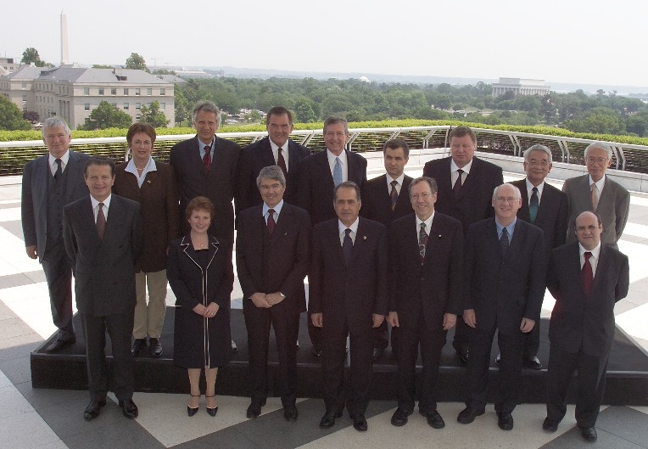
G-8, the Group of Eight
Goal of global economic stability and prosperity
United States
Japan
Germany
France
Britain
Canada
Italy
Russia (1998)
2007 G-8 leaders in Germany

Slide 22
OECD, the Organization for Economic Cooperation and Development
30 nations
Post–World War II European origin
Canada, United States (1961), Japan (1964)
Promotes economic growth and social well-being
Focuses on world trade, global issues, labor market deregulation

Slide 23
The Triad
United States, Western Europe, and Japan
Represents 75% of world income
Expanded triad includes all of North America and the Pacific Rim and most of Eastern Europe
Global companies should be equally strong in each part

Slide 24
Balance of Payments
Record of all economic transactions between the residents of a country and the rest of the world
Current account—record of all recurring trade in merchandise and services, and humanitarian aid
Trade deficit—negative current account
Trade surplus—positive current account
Capital account—record of all long-term direct investment, portfolio investment, and capital flows

Slide 25
Balance of Payments

Slide 26
Purchasing Power Parity (PPP) The Big Mac Index
Is a certain currency over-/under-valued compared to another?
Assumption is that the Big Mac in any country should equal the price of the Big Mac in the United States after being converted to a dollar price

