Slide 1
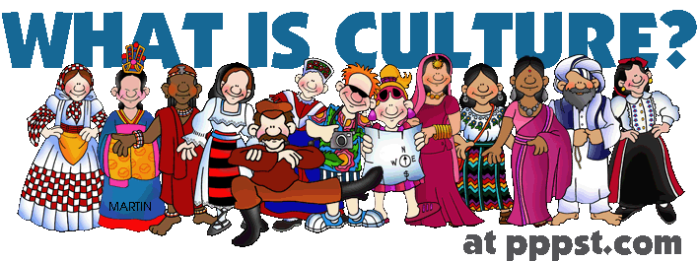
Culture!
International Business
Southeast University
M. Shahadat Hossain

Slide 2
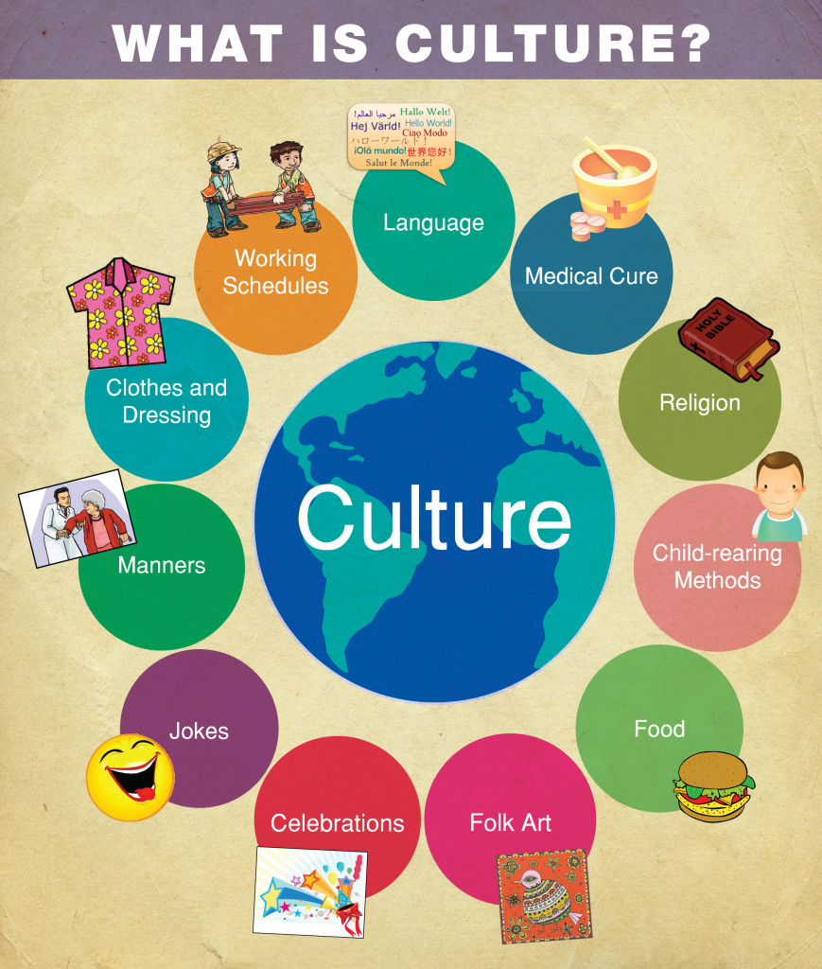
Culture
- The specific learned norms of a society; based on attitudes, values and beliefs
- "that complex whole which includes knowledge, belief, art, morals, law, custom and any other capabilities and habits acquired by man as a member of society.“ – EB Taylor

Slide 3
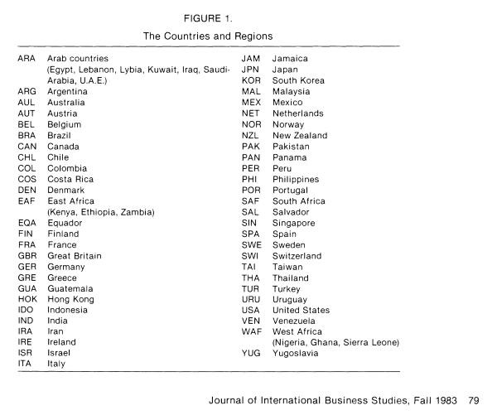

Slide 4
Hofstede’s Classification
Hofstede divided cultural dimensions of a country into five areas
The evaluation of a country’s cultural problem is in accordance with these five areas to carry out rating and scoring
Five Dimensions are:
Power Distance
Individualism and collectivism
Gender Role (Masculinity and Femininity)
Uncertainty Avoidance
The Long-term and Short-term Orientation

Slide 5
Hofstede’s Cultural Dimensions
Individualism/Collectivism | How personal needs and goals are prioritized vs. the needs and goals of the group/clan/organization
Masculine/Feminine | Masculine societies have different rules for men and women, less so in feminine cultures
Uncertainty Avoidance | How comfortable are people with changing the way they work or live (low UA) or prefer the known systems (high UA).
Power Distance | The degree people are comfortable with influencing upwards. Accept of inequality in distribution of power in society
Time Perspective | Long-term perspective, planning for future, perspective values vs. short time past and present oriented

Slide 6
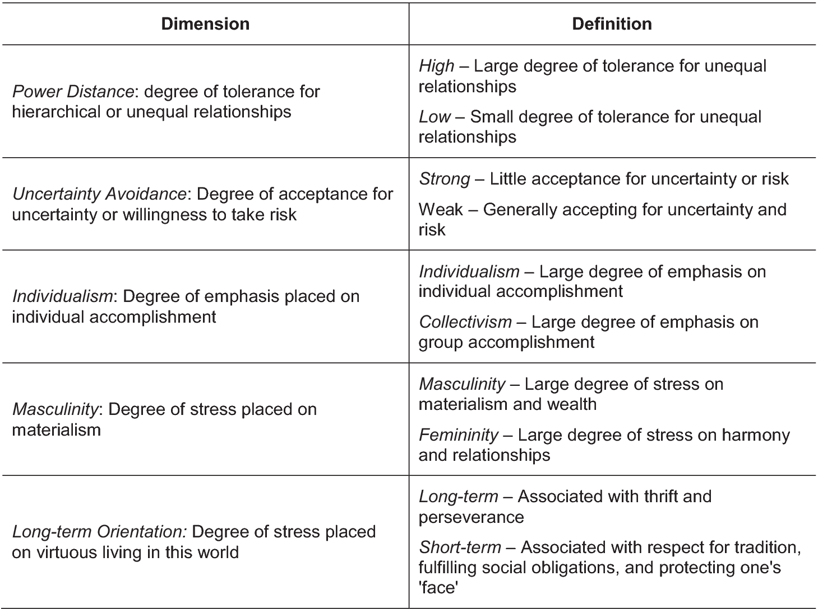
Dimensions Defined

Slide 7
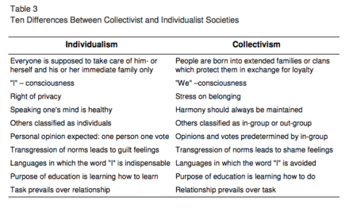
Individualism vs. Collectivism

Slide 8
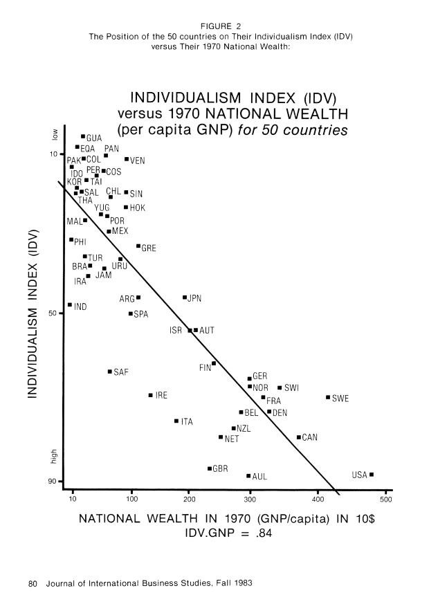

Slide 9
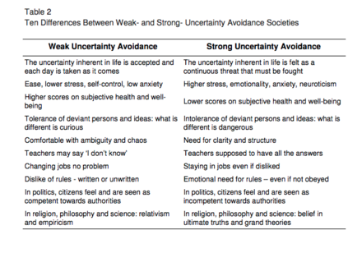
Uncertainty Avoidance

Slide 10
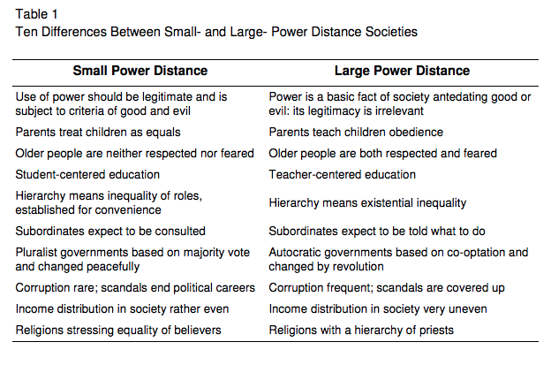
Power Distance

Slide 11
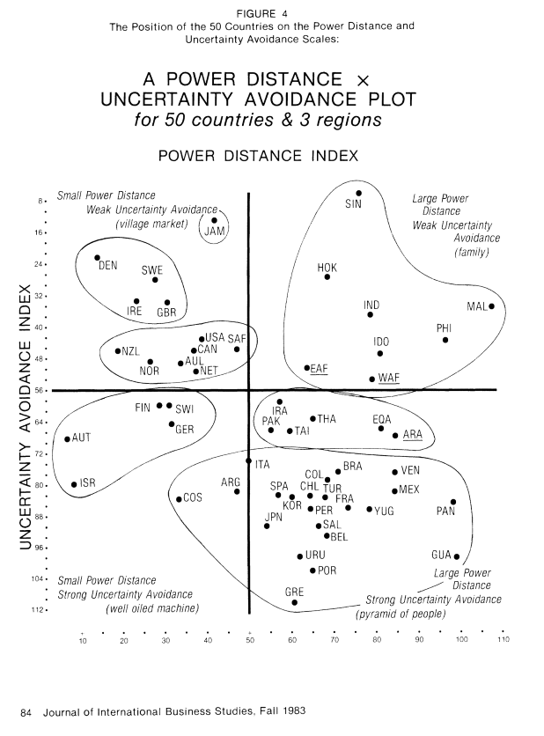

Slide 12
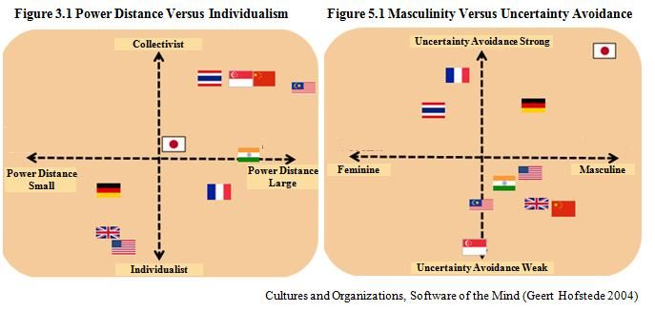
Comparison of PD/INDV UA/Gender

Slide 13
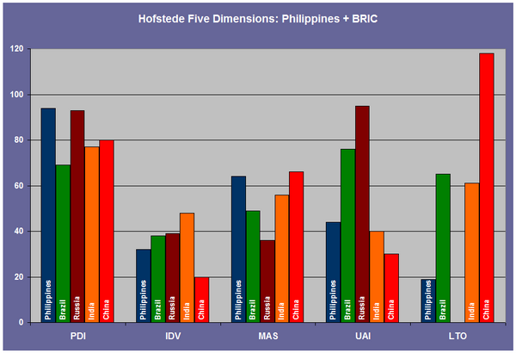
How BRIC countries stack up

Slide 14
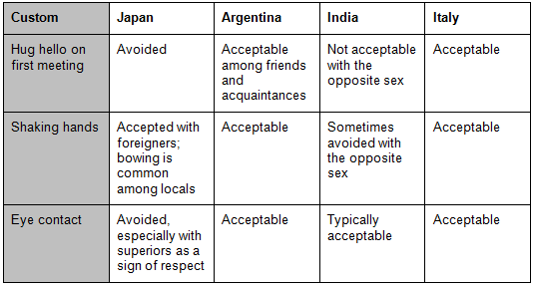
Cultural Norms

